Slide 1
Risk Management FEDlogic, Springbuk, Berkley Edge
Simone Wilkinson, CSMC Risk Management Analyst LGWIS

Slide 2
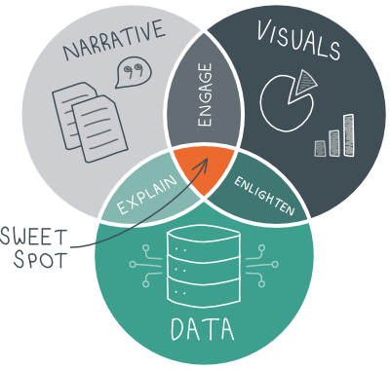
Data

Slide 3
Pre-pandemic – There were more commercial world-wide flights annually than seconds per-year.
31,536,000
seconds in one year

Slide 4
Did you know? $7.6B of eligible benefits go unused annually.

Slide 5
FEDlogic
Unlimited, confidential navigation of federal & state benefits.
Free for employees and their families.
At or approaching Medicare age and need to learn more
Approaching retirement age and want to learn more about Social Security Benefits
Diagnosis of a major illness
High risk pregnancy (twins) or child(ren) with a disability or born prematurely
Loss of spouse (or parent for children under 18)
Navigating Medicaid, Marketplace, FMLA or COBRA
Alternative healthcare avenues based on income
ESRD, ALS – other Medicare carveouts
Dependents who are pregnant and/or have an acute condition

Slide 6
“The Process” Identification and Referral.
Encourage member engagement with FEDlogic by means of education materials that are distributed to employees
Referral by Employer, including HR and Team Leads
Identify through data by Captive risk team
Referral by Leavitt Account Executive or Producer

Slide 7
Continued Efforts
Postcards to individuals ages 60 and above
Identified by Captive Risk Team, sent to FEDlogic
Twice a year zoom meetings for retirement and planning ahead
Consider a catered lunch for groups in your company
Electronic postcards and letters based on age
Monthly medical data review by Captive risk team

Slide 8
Moving Forward
FEDlogic Process or Marketing Material Questions:
anita@fedlogicgroup.com
Case specific, employee, or family questions:
Call: 877-837-4196
Email: services@fedlogicgroup.com

Slide 9
Open Q&A
Contact FEDlogic:
Call: 877-837-4196
Email: services@fedlogicgroup.com

Slide 10
Women : Men Stats
US Flight Attendants:
72.3% Female : 27.7% Male
MCUL Benefits:
21.1% Male : 78.9% Female

Slide 11
Berkley Edge

Slide 12
Notes:
- Berkley Edge – Let’s make sure everyone in this room can check off Berkley-Edge from their list.

Slide 13
Annual Costs - USA
Flight Delays:
$15 Billion
Missed prevention opportunities:
$55 Billion

Slide 15
Data Complexity Simplified
Actionable Insights
Automated Reports
Easy to Use
Analyst
- Access to normalized, enriched data
- Deep dive analysis
- Custom reporting

Slide 16
Actionable Data
Answering the, “So now what?” with industry-backed Strategies and Tools
Discover Opportunities with Insights
〉Determine Best Opportunities for Impact
〉Create Focus Populations
〉Understand Strategies
Show Value
〉Timeline Tracking
〉Medical Cost Savings & Rx Savings
〉Steered Care (Site of Service)
〉Complications Avoided

Slide 17
How Can You Help?

Slide 18
Remember This?
〉Engage w/ Staff & Benefit Team
- Starting a wellness challenge?
- Let us help with data.
〉Explain Insights – Risk Signals
- Coming Soon - Scorecards
〉Enlighten on Site of Service
〉Check-In w/ the Data

Slide 19
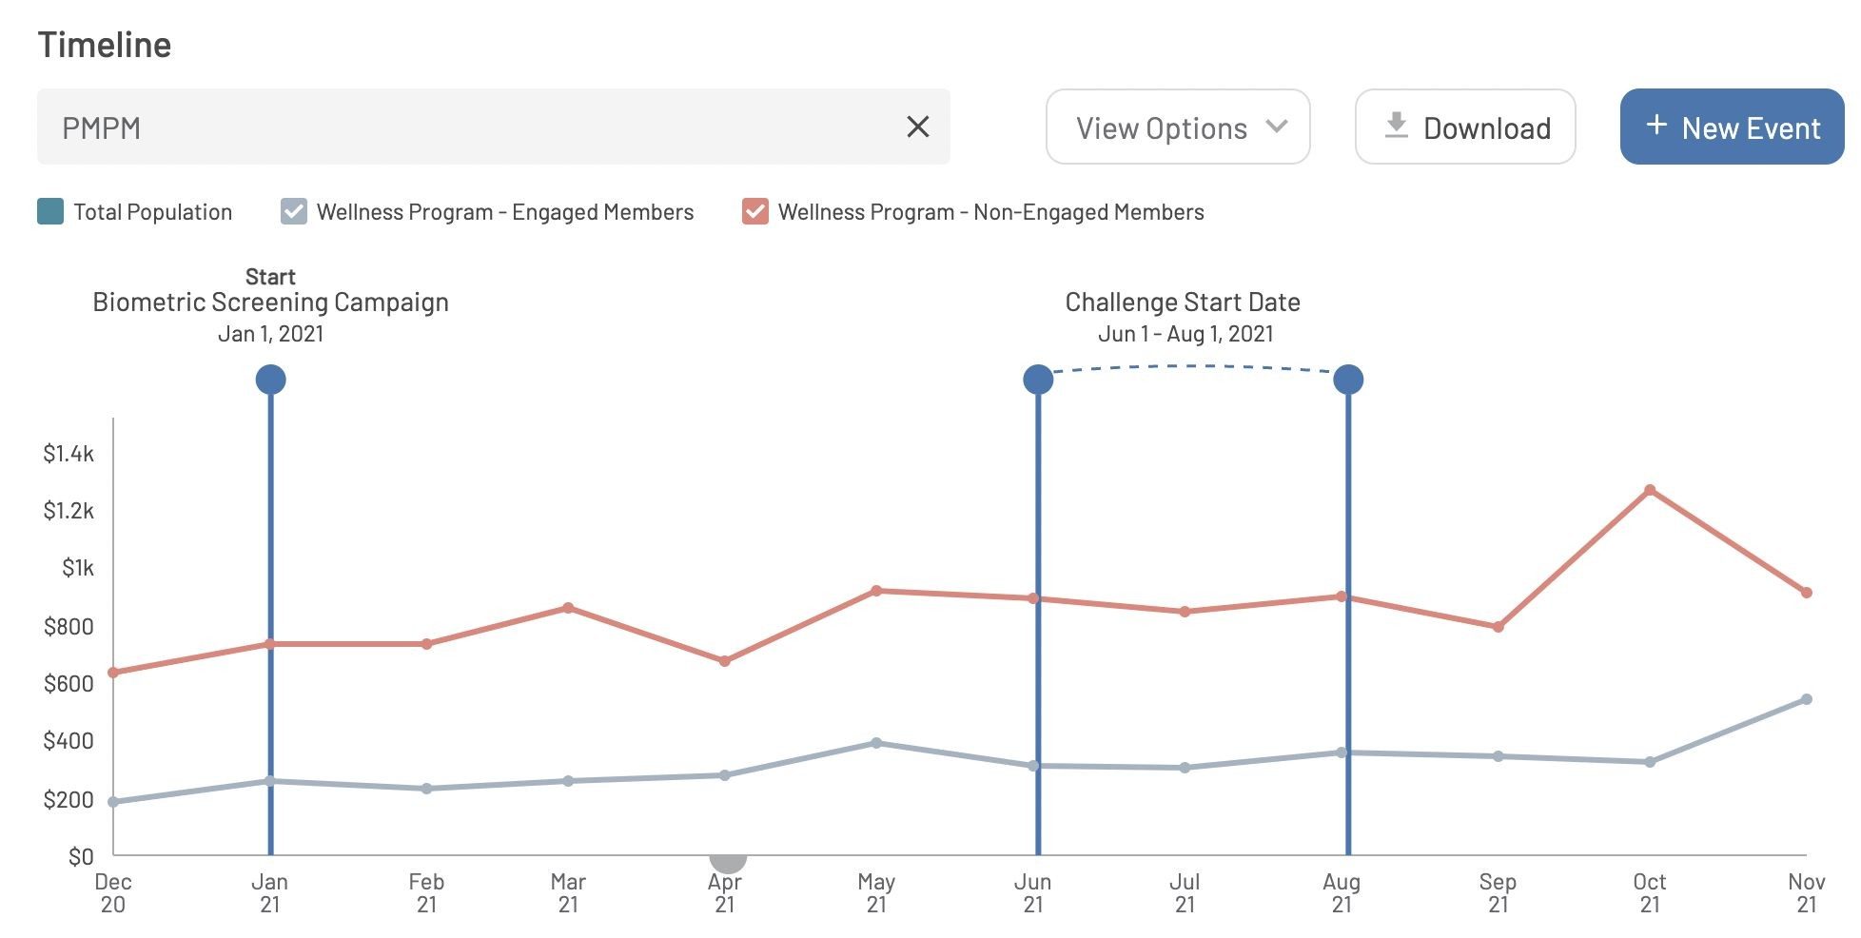
Tracking Example

Slide 20
Open Q&A

Slide 21
Great Falls MT
Est. Population 2021:
60,403
Working population at
Atlanta Intl. Airport:
63,000

Slide 22
Thank you!

